Slide 1




Slide 2
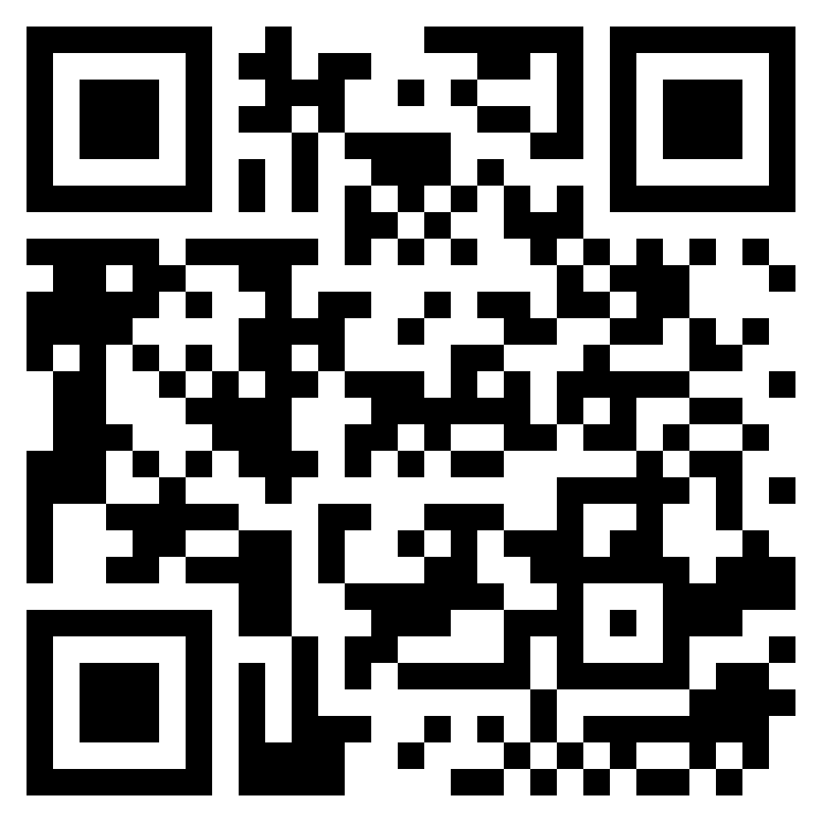
TEST TIME ON SIMPLIFICATIONS
URL: https://forms.gle/CCNuk6RbvX6z2W9z8
QR CODE:

Slide 3

COMPARING FRACTIONS

Slide 4
COMPARING FRACTIONS
Sometimes we need to compare two fractions to discover which is larger or smaller.
There are two main ways to compare fractions: - using decimals, or - using the same denominator.
Decimal Method: Convert each fraction to decimals, and then compare the decimals.
Example: Which is bigger: 3/8 or 5/12 ?
3/8 = 0.375 and 5/12 = 0.4166
So 5/12 is bigger.

Slide 5
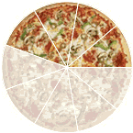
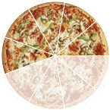
COMPARING FRACTIONS
Denominator method:
The denominator is the bottom number in a fraction. It shows how many equal parts the item is divided into
Which is bigger 4/9 or 5/9?
When two fractions have the same denominator they are easy to compare:

Slide 6
Question: Q01
By how much does 7/(8/9) exceeds (7/8)/9?
2 5/8
3 1/9
7 7/9
9 1/7
Answer : C

Slide 7
Explanation: Q01
Here, we have to find the value of 7/(8/9) - (7/8)/9. (7 x 9/8) - [(7/(8 x 9)] 63/8 - 7/72 [(63 x 9) - 7] / 72 567 - 7/72 = 560/72 = 70/9 = 7 7/9. Hence, 7/(8/9) is greater than (7/8)/9 by 7 7/9.

Slide 8
Question: Q02
Which of the following fraction is smallest?
23/28
14/15
15/19
21/24
Answer : C

Slide 9
Explanation: Q02
23 =0.821
28
14 = 0.933
15
15 = 0.7894
19
21 = 0.875
24
So, 15 = 0.7894 is smallest.
19

Slide 10
Question: Q03
0.363*0.522+0.363*0.478 = ?
0.522
0.845
0.363
0.985
Answer : C

Slide 11
Explanation: Q03
Given Expression= 0.363*(0.522+0.478)= 0.363*1= 0.363

Slide 12
Question: Q04
The value of 34.31*0.473*1.567 is close to
0.0673*23.25*7.57
2.0
1.15
2.05
2.15
Answer : D

Slide 13
Explanation: Q04
34.31*0.473*1.567 = 25.4303 = 2.15
0.0673*23.25*7.57 11.845

Slide 14
Question: Q05
If 5.51*10^{k} = 0.0551, then the value of k is:
–4
–3
–2
–1
Answer : C

Slide 15
Explanation: Q05
10k = 0.0551 = 5.51 = 5.51* 102 = 1 = 10⁻²
5.51 551 551* 102 10²

Slide 16
Question: Q06
The value of (2.502+0.064)² - (2.502-0.064)²
2.502*0.064
4
235
25
3
Answer : A

Slide 17
Explanation: Q06
(2.502+0.064)² - (2.502-0.064)² = (a+b)² - (a-b)² = 4ab = 4
2.502*0.064 ab ab

Slide 18
Question: Q07
The value of 4.5*1.8+4.5*8.2
1.5*4.5+1.5*5.5
10
8
5
3
Answer : D

Slide 19
Explanation: Q07
4.5*1.8+4.5*8.2 = 4.5 (1.8+8.2) = 4.5*10 = 45 =3
1.5*4.5+1.5*5.5 1.5 (4.5+5.5) 1.5*10 15

Slide 20
Question: Q08
The value of (.02)² + (0.52)² + (0.035)²
(0.002)² + (0.052)² + (0.0035)²
100
1000
001
0001
Answer : A

Slide 21
Explanation: Q08
(.02)² + (0.52)² + (0.035)² = a²+b²+c²
(0.002)² + (0.052)² + (0.0035)² ( a /10) ²+ ( b/10) ² + ( c/10) ² ,
where a= .02, b= .52, c= .035
= 100(a²+b²+c²) = 100
a²+b²+c²

Slide 22
Question: Q09
Compare 3/5 and 4/7
3/5 > 4/7
3/5 < 4/7
3/5 = 4/7
None of these
Answer : A

Slide 23
Explanation: Q09
To compare such fractions, find out LCM of the denominators. Here, LCM(5, 7) = 35
Now , convert each of the given fractions into an equivalent fraction with 35 (LCM) as the denominator.
The denominator of 3/5 is 5. 5 needs to be multiplied with 7 to get 35. Hence,
3/5=3×7/5×7=21/35
The denominator of 4/7 is 7. 7 needs to be multiplied with 5 to get 35. Hence,
4/7=4×5/7×5=20/35
21/35>20/35
Hence, 3/5>4/7

Slide 24
Question: Q10
Which of the following fraction is arranged in ascending order of their value?
1/4, 2/7, 3/4, 4/7, 5/7, 6/5
1/4, 2/7, 4/7, 5/7, 3/4, 6/5
2/7, 1/4, 4/7, 3/4, 5/7, 6/5
2/7, 1/4, 4/7, 5/7, 3/4, 6/5
Answer : B

Slide 25
Explanation: Q10
Converting the given fractions into decimal numbers, we have 1/4 = 0.25 2/7 = 0.28 3/4 = 0.75 4/7 = 0.57 5/7 = 0.71 6/5 = 1.2
So, 0.25 < 0.28 < 0.57 < 0.71 < 0.75 < 1.2
Corresponding fraction is 1/4 < 2/7 < 4/7 < 5/7 < 3/4 < 6/5
Hence the answer is option b.

Slide 26
Question: Q11
Which of the following fraction is greater than 4/5 and less than 6/7?
2/3
3/4
5/6
10/11
Answer : C

Slide 27
Explanation: Q11
We have to find X such that 4/5 < X < 6/7
Converting each fraction into decimal form, we get:
4/5 = 0.8 6/7 = 0.85
We have to find the fraction which is greater than 0.8and less than 0.85. Now, 2/3 = 0.66 3/4 = 0.75 5/6 = 0.83 10/11 = 0.91
Clearly, 0.83 lies between 0.8 and 0.85. Required fraction is 5/6

Slide 28
Question: Q12
The denominator of a fraction exceeds its numerator by 7. If the numerator as well as the denominator is increased by 9, the fraction becomes 2/3. Which of the following is the original fraction?
5/12
4/11
6/13
none of these
Answer : A

Slide 29
Explanation: Q12
Let the required fraction be p/q.
Given that, q exceeds p by 7; i.e., q - 7 = p q - p = 7 ...(1)
If we increase the numerator as well as the denominator by 9 it becomes (p + 9)/(q + 9)
Given that, (p + 9)/(q + 9) = 2/3 3(p+9) = 2(q+9) 3p + 27 = 2q + 18 2q-3p = 9 ...(2)
Multiplying eqn(1) by 2, we get 2q - 2p = 14......(3)
Now, subtracting eqn(2) from eqn (3), we get p = 14 - 9 = 5 Putting p value in (1), we get q = 12.
Hence, the required fraction is p/q = 5/12

Slide 30
Question: Q13
The sum of the numerator and denominator of a fraction is 13. If we add 3 and 9 to numerator and denominator respectively, it becomes 2/3. The fraction is:
5/8
6/7
7/6
8/5
Answer : C

Slide 31
Explanation: Q13
Let the required fraction be p/q.
Given that, sum of the numerator and denominator of a fraction is 13; i.e., p + q = 13 ...(1)
Adding 3 to numerator and 9 to denominator, we have,
(P+3)/(q+9) = 2/3 3(P+3) = 2(q+9) 3p+9 = 2q+18 3p-2q = 9 ...(2)
Multiply eqn (1)by 2, 2p + 2q = 26...(3) Adding (2) and (3),
5p = 35 p = 7.
Putting p value in (1), we get q = 13 - p = 13 - 7 = 6.
Hence the required fraction is p/q = 7/6

Slide 32
Question: Q14
By how much is four-seventh of 560 greater than five-eighth of 400?
210
70
90
110
Answer : B

Slide 33
Explanation: Q14
We have to find, the value of 4/7 of 560 - 5/8 of 400. 4/7 x 560 - 5/8 x 400 = (4 x 80) - (5 x 50) = 320 - 250 = 70 Hence, four-seventh of 560 is greater than five-eighth of 400 by 70.

Slide 34




THANK YOU
+91 78150 95095
codemithra@ethnus.com
www.codemithra.com

